Slide 1
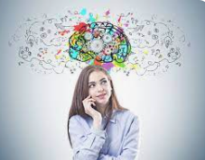
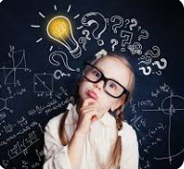
Developing a Mathematical Mindset
Promoting Confidence and Resilience in Maths

Slide 2
Aim of session
We want to build girls’ confidence in Maths. There is a gap between girls and boys and we believe that much of that is down to confidence in girls rather than ability, therefore we want to break those barriers down to ensure that all children regardless of their gender can succeed and thrive in maths.

Slide 3
Making Maths Count
Too many of us are happy to label ourselves as “no good with numbers.”
Historically, girls and Maths, alongside the other STEM subjects, have had a tempestuous relationship. These subjects have been seen as being “for boys” by many young pupils, and it appears that there is still an uphill battle to change this perception.
This raises questions -
– Is it the case that girls simply have no interest in continuing into careers in Maths?
– Do they feel they will not fit in if they do?
– If they feel it is not for them, how early in life does such a mindset settle in?
– Most importantly, can we reverse pupils current expectations around maths for girls?
Promoting the value of maths as
an essential skill for every career.

Slide 4
What does the research say…
But are boys naturally better than girls? Are they born with a natural aptitude towards maths? (Is anybody for that matter?). The answer is simply, ‘no’. A number of studies have been carried out and the results show that the reason boys tend to perform better is not due to a natural aptitude:
Gender disparities in performance do not stem from
innate differences in aptitude (to maths). (OECD, 2015)
…(studies do) not support the position of a male ‘intrinsic aptitude’
for mathematics….there are no gender differences in children’s
cognitive abilities and therefore no difference, on average,
in the potential for females and males to achieve
in mathematics (Spelke, 2005).

Slide 5
Have you heard?
Parent
‘He/she is just not a maths person. He/she gets it from
me. I was never very good at maths at school either’
(usually followed by laughter)
Parent/teacher
‘Don’t worry, obviously you don’t have a maths brain.
You are better suited to ………’
Pupil
‘I am never going to get this’

Slide 6
Key Messages
Everyone can learn maths
Believe in yourself
Mistakes are important
Speed is not important

Slide 7
Research findings
If a mother communicates a negative attitude towards mathematics their
daughter’s attainment in mathematics will decline immediately.
Dweck, Boaler (2015)
Encouraging students to use only one method (algorithmic) to solve problems,
they lose some of their capacity for flexible and creative thought.
They become less willing to attempt problems in alternative ways and become
afraid to take risks’
Narode,Board and Devenport (1993)
Many pupils’, parents and even teachers believe that some people have an innate ability
in maths and that people who are good at maths have ‘maths brains’.
There is also a firmly held view that speed and fact recall are the making
of a good mathematician. This has led to a huge problem with maths anxiety in pupils.
Dweck, Boaler (2015)

Slide 8
Change your Words
Change your Mindset.
I am not good at this
How could I get better at this?

Slide 9
Change your Words
Change your Mindset.
This is too hard
This may take some time and effort but I can do this.

Slide 10
Change your Words
Change your Mindset.
I give up
I’ll try some strategies I have learned.

Slide 11
Change your Words
Change your Mindset.
It’s good enough.
Is this really my best effort?

Slide 12
Change your Words
Change your Mindset.
I’ll never be as smart as them.
I will figure out how they do it and try it myself.

Slide 13
Change your Words
Change your Mindset.
I made a mistake.
Mistakes help me improve.

Slide 14
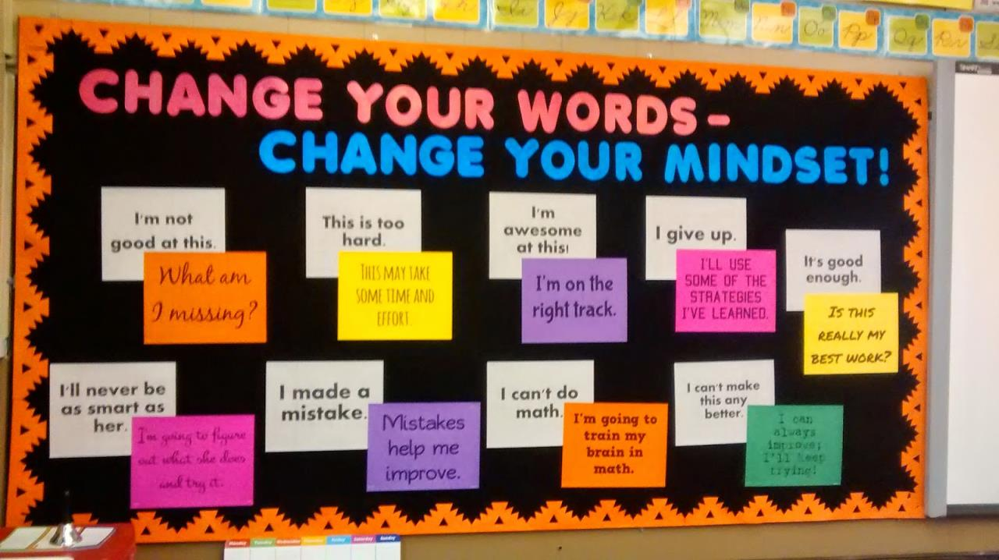

Slide 15
If you hear…
‘I am just not a maths person.’
‘You obviously don’t have a maths brain.
You are better suited to ………’
‘I am never going to get this’
‘I can’t do maths’

Slide 16
The power of Yet.
I can’t do this …
YET!
YET!
I am not capable of solving this problem …

Slide 17
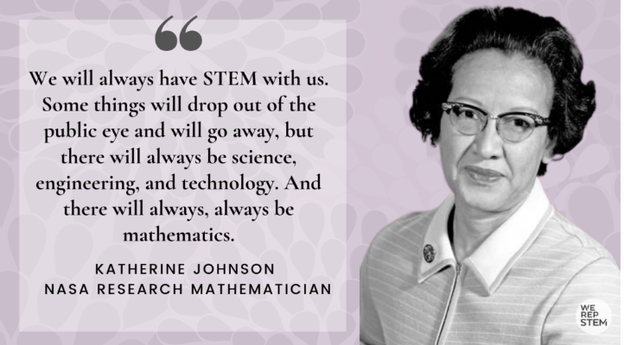
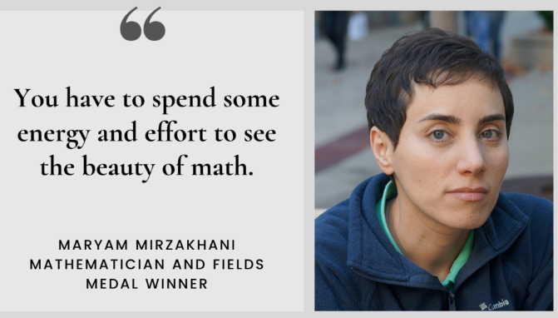
Famous Women Mathematicians
Chances are you’re probably well aware of Newton, Einstein and Turing, but when it comes to famous female mathematicians, their achievements are less well known.

Slide 18

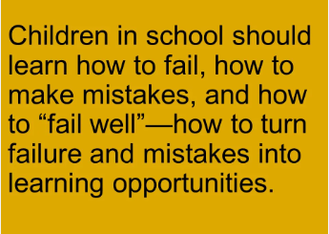
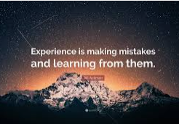

Slide 19

It took me
17 years and 114 days
to become an
overnight success
-Lionel Messi

Slide 20
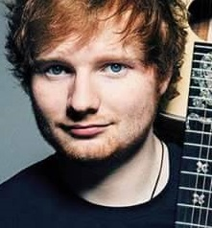
“People tell me that I’m born with natural talent
I’m like . . . uh no!
. . . I just practice.”
- Ed Sheeran

Slide 21
“People tell me that I’m born with natural talent
I’m like . . . uh no!
. . . I just practice.”
- Ed Sheeran

Slide 22
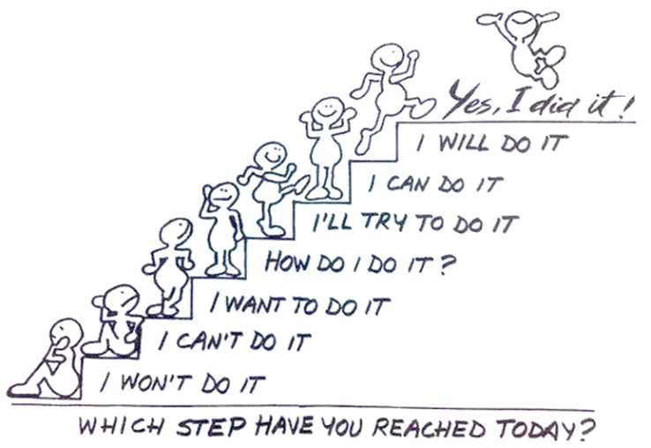
Growth Mindset
Fixed Mindset

Slide 23
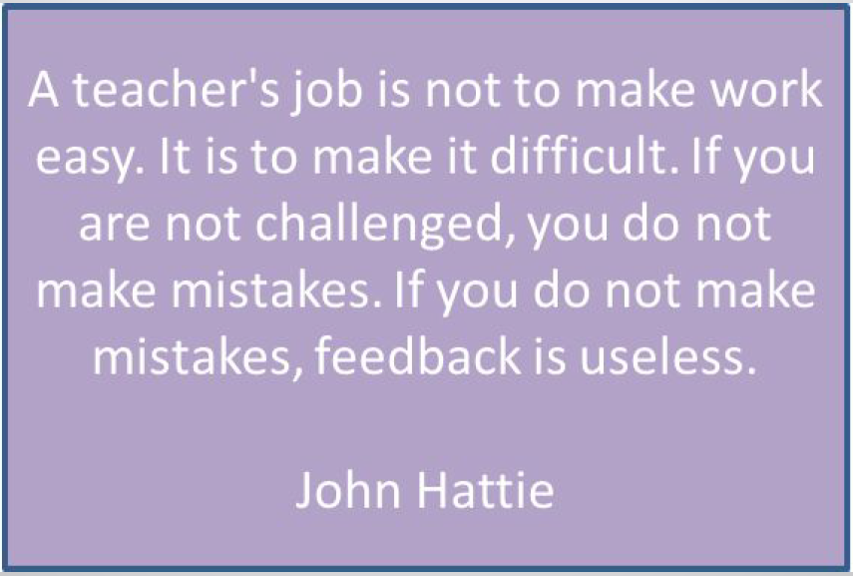

Slide 24
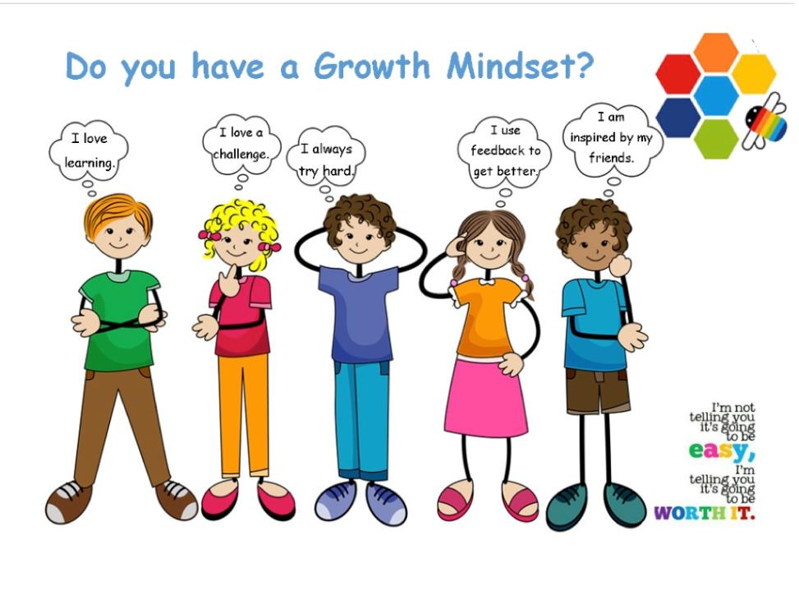

Slide 25
Our Maths lessons at Chetwynd
Within our lessons children have the chance
to use equipment, using pictorial representations and completing written calculations.

Slide 26
Year 5 Place value PPT
See separate PPT

Slide 27

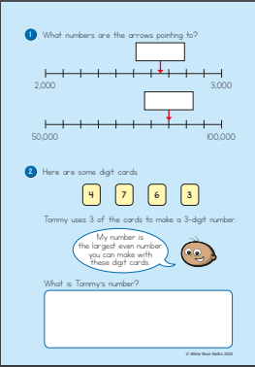
Parent Booklets – white rose education.com

Slide 28


